Slide 1
Introduction to Probability
Unit 3

Slide 2
Learning Objectives
Understand uncertainty and how probability concepts are used for measuring and modelling uncertainty.
Learn basic concepts in probability: axioms of probability, frequency estimate of probability, conditional probability and Bayes’ theorem.
Learn how simple probability rules are used for solving business problems using association rule mining and its applications in market basket analysis and recommender systems.
Understand the concept of random variables, discrete and continuous random variables, probability density function, and cumulative distribution function.
Understand various discrete distributions such as binomial distribution, Poisson distribution, and geometric distribution and their applications for solving business problems.
Understand various continuous distributions such as uniform, exponential, normal, chi-square, t, and F distributions and their applications for solving business problems.

Slide 3
Introduction to Probability
One of the primary objectives in analytics is to measure the uncertainty associated with an event or key performance indicator.
Axioms of probability and the concept of random variable are fundamental building blocks of analytics that are used for measuring uncertainty associated with key performance indicators of importance for a business.
Probability theory is the foundation on which descriptive and predictive analytics models are built.

Slide 4
Introduction to Probability
Analytics applications involve tasks such as prediction of probability of occurrence of an event, testing a hypothesis, building models to explain variation in a variable of importance to the business such as profitability, market share, demand, etc.
Many important tasks in analytics deal with uncertain events and it is essential to understand probability theory that can be used to predict and measure uncertain events.

Slide 5
Introduction to Probability
  Probability quantifies the uncertainty of the outcomes of a random variable. Or, it quantifies likelihood or possibilities of an event.
  Specifically, it quantifies how likely a specific outcome is for a random variable, such as the flip of a coin, the roll of a dice, or drawing a playing card from a deck.
  For a random variable x, P(x) is a function that assigns a probability to all values of x.
  Probability Density of x = P(x)

Slide 6
PROBABILITY THEORY – TERMINOLOGY
Random Experiment
Random experiment is an experiment in which the outcome is not known with certainty. That is, the output of a random experiment cannot be predicted with certainty.
Predictive analytics mainly deals with random experiments such as:
  predicting quarterly revenue of an organization
  customer churn (whether a customer is likely to churn or how many customers are likely to churn before next quarter)
  demand for a product at a future time period
  number of views for an YouTube video
  outcome of a football match (win, draw or lose), etc.

Slide 7
PROBABILITY THEORY – TERMINOLOGY
Sample Space
Sample space is the universal set that consists of all possible outcomes of an experiment. Sample space is usually represented using the letter ‘S’ and individual outcomes are called the elementary events.
The sample space can be finite or infinite.
Few random experiments and their sample spaces are discussed below:
Experiment: Outcome of a football match
Sample Space = S = {Win, Draw, Lose}
Experiment: Predicting customer churn at an individual customer level
Sample Space = S = {Churn, No Churn}
Experiment: Predicting percentage of customer churn
Sample Space = S = {X | X ∈ R, 0 ≤ X ≤ 100}, that is X is a real number that can take any value between 0 and 100 percentage.
Experiment: Life of a turbine blade used in an aircraft engine
Sample Space = S = {X | X ∈ R, 0 ≤ X < ∞}, that is X is a real number that can take any value between 0 and ∞.

Slide 8
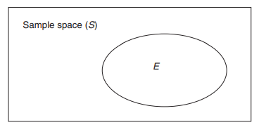
PROBABILITY THEORY – TERMINOLOGY
Event
Event (E) is a subset of a sample space and probability is usually calculated with respect to an event.
An event can be represented using the Venn diagram in Figure below
The Venn diagram in Figure indicates that the event E is a subset of the sample space S, that is, E ⊂ S (E is a subset of S).
Consider the random experiment that predicts number of customers who are likely to churn within a quarter from a customer base of 100 customers.

Slide 9
PROBABILITY THEORY – TERMINOLOGY
The corresponding sample space = {X| X ∈ Z, 0 ≤ X ≤ 100}, that is X is a real number that can take any integer value between 0 and 100. Now we can define several events such as:
  Event A = Number of customer churn less than 10
  Event B = Number of customer churn between 10 and 30
  Event C = Number of customer churn exceeding 30

Slide 10

PROBABILITY THEORY – TERMINOLOGY
Probability Estimation using Relative Frequency
The classical approach to probability estimation of an event is based on the relative frequency of the occurrence of that event. According to frequency estimation, the probability of an event X, P(X), is given by:
For example, say a company has 1000 employees and every year about 200 employees leave the job. Then the probability of attrition of an employee per annum is 200/1000 = 0.2.

Slide 11
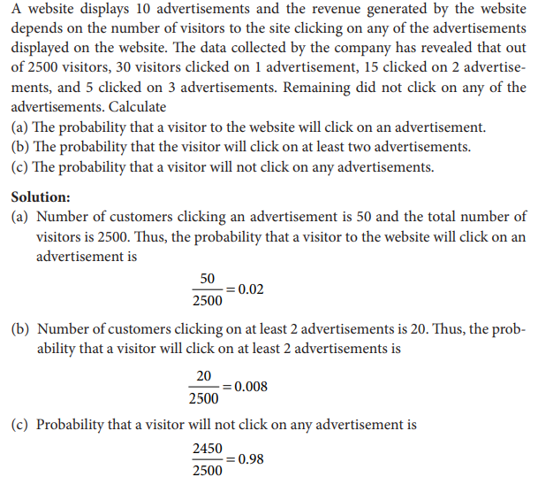

Slide 12
Algebra of Events
Assume that X, Y and Z are three events of a sample space. Then the following algebraic relationships are valid and are useful while deriving probabilities of events:
Commutative rule: X ∪ Y = Y ∪ X and X ∩ Y = Y ∩ X
Associative rule: (X ∪ Y) ∪ Z = X ∪ (Y ∪ Z) and (X ∩ Y) ∩ Z = X ∩ (Y ∩ Z)
Distributive rule: X ∪ (Y ∩ Z) = (X ∪ Y) ∩ (X ∪ Z)
X ∩ (Y ∪ Z) = (X ∩ Y) ∪ (X ∩ Z)
The above rules of algebra will be useful while calculating the probability of events. The following rules known as DeMorgan’s Laws on complementary sets are useful while deriving probabilities:
(X ∪ Y)^{C} = X^{C} ∩ Y^{C}
(X ∩ Y)^{C} = X^{C} ∪ Y^{C}
where X^{C} and Y^{C} are the complementary events of X and Y, respectively.

Slide 13
FUNDAMENTAL CONCEPTS IN PROBABILITY – AXIOMS OF PROBABILITY
According to axiomatic theory of probability, the probability of an event E satisfies the following axioms:
The probability of event E always lies between 0 and 1. That is, 0 ≤ P(E) ≤ 1.
The probability of the universal set S is 1. That is, P(S) = 1.
P(X ∪ Y) = P(X) + P(Y), where X and Y are two mutually exclusive events.

Slide 14
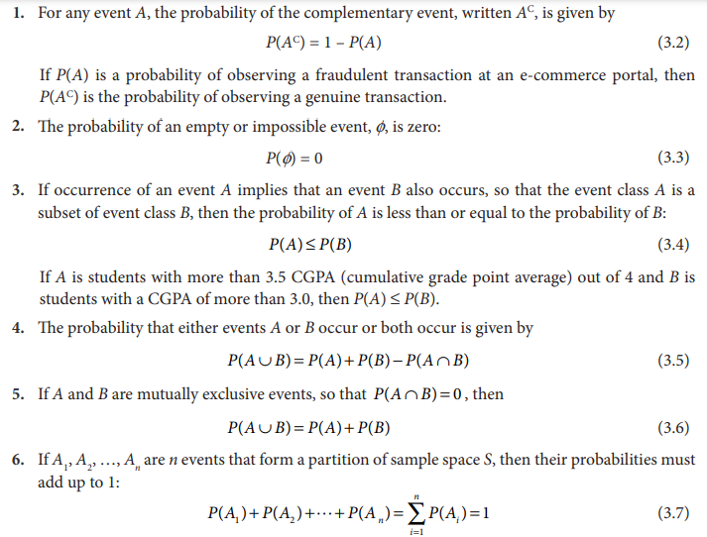
The following elementary rules of probability are directly deduced from the original three axioms of probability, using the set theory relationships:

Slide 15
Example
The probability of an event not occurring, is called the complement.
This can be calculated by one minus the probability of the event, or 1 – P(A).
For example, the probability of not rolling a 5 would be
1 – P(5) or 1 – 0.166 or about 0.833 or about 83.333%.
Probability of Not Event A = 1 – P(A)
Probability can range in from 0 to 1, where 0 means the event to be an impossible one and 1 indicates a certain event.
The probability of all the events in a sample space adds up to 1.

Slide 16
Basic Probability Concepts
  Marginal Probability
  Joint Probability
  Conditional Probability
  Probability Trees and Bayes’ Theorem

Slide 17
Problems and Solutions on Probability
Question 1: Find the probability of ‘getting 3 on rolling a die’.
Solution:
Sample Space = S = {1, 2, 3, 4, 5, 6}
Total number of outcomes = n(S) = 6
Let A be the event of getting 3.
Number of favorable outcomes = n(A) = 1
i.e. A = {3}
Probability, P(A) = n(A)/n(S) = 1/6
Hence, P(getting 3 on rolling a die) = 1/6

Slide 18
Question 2: Draw a random card from a pack of cards. What is the probability that the card drawn is a face card?
Solution:
A standard deck has 52 cards.
Total number of outcomes = n(S) = 52
Let E be the event of drawing a face card.
Number of favorable events = n(E) = 4 x 3 = 12 (considered Jack, Queen and King only)
Probability, P = Number of Favorable Outcomes/Total Number of Outcomes
P(E) = n(E)/n(S)
= 12/52
= 3/13
P(the card drawn is a face card) = 3/13

Slide 19
Question 3: A vessel contains 4 blue balls, 5 red balls and 11 white balls. If three balls are drawn from the vessel at random, what is the probability that the first ball is red, the second ball is blue, and the third ball is white?
Solution:
The probability to get the first ball is red or the first event is 5/20.
Since we have drawn a ball for the first event to occur, then the number of possibilities left for the second event to occur is 20 – 1 = 19.
Hence, the probability of getting the second ball as blue or the second event is 4/19.
Again with the first and second event occurring, the number of possibilities left for the third event to occur is 19 – 1 = 18.
And the probability of the third ball is white or the third event is 11/18.
Therefore, the probability is 5/20 x 4/19 x 11/18 = 44/1368 = 0.032.
Or we can express it as: P = 3.2%.

Slide 20
Question 4: Two dice are rolled, find the probability that the sum is:
equal to 1
less than 13
Solution:
To find the probability that the sum is equal to 1 we have to first determine the sample space S of two dice as shown below.
S = { (1,1),(1,2),(1,3),(1,4),(1,5),(1,6)
(2,1),(2,2),(2,3),(2,4),(2,5),(2,6)
(3,1),(3,2),(3,3),(3,4),(3,5),(3,6)
(4,1),(4,2),(4,3),(4,4),(4,5),(4,6)
(5,1),(5,2),(5,3),(5,4),(5,5),(5,6)
(6,1),(6,2),(6,3),(6,4),(6,5),(6,6) }
So, n(S) = 36
1) Let E be the event “sum equal to 1”. Since, there are no outcomes which where a sum is equal to 1, hence, P(E) = n(E) / n(S) = 0 / 36 = 0
2) Let B be the event of getting the sum of numbers on dice is less than 13.
From the sample space, we can see all possible outcomes for the event B, which gives a sum less than B. Like: (1,1) or (1,6) or (2,6) or (6,6). So you can see the limit of an event to occur is when both dies have number 6, i.e. (6,6). Thus, n(B) = 36
Hence, P(B) = n(B) / n(S) = 36 / 36 = 1

Slide 21
Equally Likely Events
When the events have the same theoretical probability of happening, then they are called equally likely events.
The results of a sample space are called equally likely if all of them have the same probability of occurring.
  Getting 3 and 5 on throwing a die
  Getting an even number and an odd number on a die
  Getting 1, 2 or 3 on rolling a die

Slide 22
Complementary Events
The possibility that there will be only two outcomes which states that an event will occur or not.
Basically, the complement of an event occurring in the exact opposite that the probability of it is not occurring. Some more examples are:
It will rain or not rain today
The student will pass the exam or not pass.
You win the lottery or you don’t.

Slide 23
Independent Events
Independent events are those events whose occurrence is not dependent on any other event. For example, if we flip a coin in the air and get the outcome as Head, then again if we flip the coin but this time we get the outcome as Tail. In both cases, the occurrence of both events is independent of each other.
If the probability of occurrence of an event A is not affected by the occurrence of another event B, then A and B are said to be independent events.
Consider an example of rolling a die.
If A is the event ‘the number appearing is odd’ and B be the event ‘the number appearing is a multiple of 3’, then
P(A)= 3/6 = 1/2 and P(B) = 2/6 = 1/3
Also A and B is the event ‘the number appearing is odd and a multiple of 3’ so that
P(A ∩ B) = 1/6
P(A│B) = P(A ∩ B)/ P(B) = (1/6) / (1/3) = 1/2
P(A) = P(A│B) = 1/2 , which implies that the occurrence of event B has not affected the probability of occurrence of the event A .
If A and B are independent events, then P(A│B) = P(A)
Using Multiplication rule of probability, P(A ∩ B) = P(B) .P(A│B)
P(A ∩ B) = P(B) .P(A)

Slide 24
Mutually Exclusive Events
Two events are said to be mutually exclusive if they cannot occur at the same time or simultaneously.
They are also called disjoint events.
If two events are considered disjoint events, then the probability of both events occurring at the same time will be zero.
If the events A and B are not mutually exclusive, the probability of getting A or B that is P (A ∪ B) formula is given as follows:
P (A ∪ B) = P(A) + P(B) – P (A and B)
Here P (A and B) means P(A ∩ B) is zero
When tossing a coin, the event of getting head and tail are mutually exclusive.
In a six-sided die, the events “2” and “5” are mutually exclusive.

Slide 25
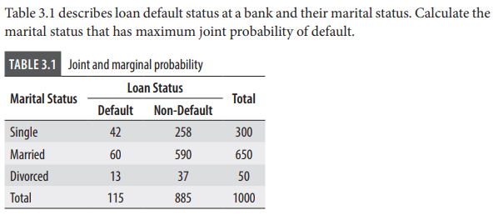
Marginal Probability
The probability of an event occurring (p(A)), it may be thought of as an unconditional probability.
It is not conditioned on another event.
Example: the probability that a card drawn is red
(p(red) = 0.5).
Another example: the probability that a card drawn is 4
(p(four)=1/13).

Slide 26
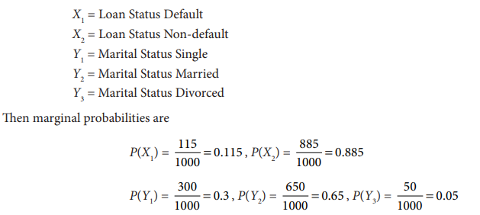
Marginal Probability

Slide 27
Joint Probability
It is the probability of two different event A and event B occurring at the same time.
It is the probability of the intersection of two or more events.
The probability of the intersection of A and B may be written p(A ∩ B) or p(A and B).
Example: the probability that a card is a four and red =
p(four and red) = 2/52=1/26.
(There are two red fours in a deck of 52, the 4 of hearts and the 4 of diamonds).

Slide 28
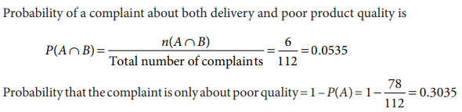
Joint Probability
Question 1 At an e-commerce customer service centre a total of 112 complaints were received. 78 customers complained about late delivery of the items and 40 complained about poor product quality.
  (a) Calculate the probability that a customer complaint will be about both late delivery and product quality.
  (b) What is the probability that a complaint is only about poor quality of the product?
  Solution
  Let A = Late delivery and B = Poor quality of the product. Let n(A) and n(B) be the number of cases in favour of A and B. So n(A) = 78 and n(B) = 40. Since the total number of complaints is 112 (here complaints is treated as the sample space), hence
  n(A ∩ B) = 118 – 112 = 6

Slide 29
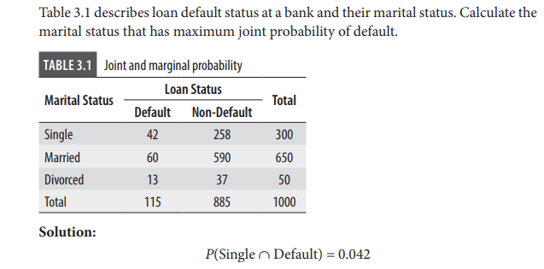

Joint Probability

Slide 30

Conditional Probability
If A and B are events in a sample space, then the conditional probability of the event B given that the event A has already occurred, denoted by P(B|A), is defined as:
The conditional probability symbol P(B|A) is read as the probability of B given A. It is necessary to satisfy the condition that P(A) > 0, because it does not make sense to consider the probability of B given that event A is impossible.
the conditional probability of default given divorced is
P(Default|Divorced) = 0.013/0.05 = 0.26 and similarly probability of default given single is
P(Default|Single) = 0.042/0.3 = 0.14

Slide 31
APPLICATION OF SIMPLE PROBABILITY RULES – ASSOCIATION RULE LEARNING
We can use simple probability concepts such as joint probability and conditional probability to solve analytics problems such as market basket analysis and recommender systems using algorithms such as Association Rule Learning (aka Association Rule Mining).
Association rule mining is one of the popular algorithms used to solve problems such as market basket analysis and recommender systems.
Market basket analysis (MBA) is used frequently by retailers to predict products a customer is likely to buy together, which further can be used for designing planogram and product promotions. The primary objective of MBA is to find probability of buying two products (A and B) together.
Recommender systems are models that produce list of recommendations to a customer on products such as books, movies, news items, etc. and is an important analytics technique.

Slide 32
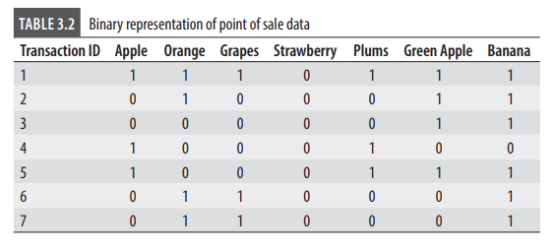
Association Rule Learning
In general, association rule learning (also known as association rule mining) is a method of finding association between different entities in a database.
In a retail context, association rule learning is a method for finding association relationships that exist in frequently purchased items.
Association rule is a relationship of the form X → Y (that is, X implies Y). Here, X and Y are two mutually exclusive sets (set of stock keeping units or SKUs).
In Table 3.2, transaction ID is the transaction reference number and apple, orange, etc. are the different SKUs sold by the store. Binary code is used to represent whether the SKU was purchased (equal to 1) or not (equal to 0) during a transaction. The strength of association between two mutually exclusive subsets can be measured using ‘support’, ‘confidence’, and ‘lift’.

Slide 33



Association Rule Learning
Support between two sets (of products purchased) is calculated using the joint probability of those events:
where n(X ∩ Y) is the number of times both X and Y is purchased together and N is the total number of transactions. That is, support is proportion of times X and Y are purchased together.
Confidence is the conditional probability of purchasing product Y given the product X is purchased.
The third measure in association rule mining is lift, which is given by
Lift overcomes one of the disadvantages of using confidence. For example, P(X) could be very small, making it less attractive for MBA and recommendation among millions of SKUs that a retailer may be selling.

Slide 34
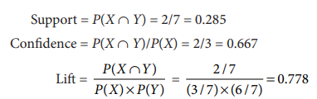
Association Rule Learning
In Table 3.2, assume that X = Apple and Y = Banana. Then
Association rules can be generated based on threshold values of support, confidence and lift. For example, assume that the cut-off for support is 0.25 and confidence is 0.5 (lift should be greater than 1). Then we can conclude that X implies Y (that is, purchase of apple implies purchase of banana, however this rule will be ineffective since lift is less than 1).

Slide 35
Bayes’ Theorem
It describes the probability of an event, based on prior knowledge of conditions that might be related to that event.
It can also be considered for conditional probability examples.
It is used where the probability of occurrence of a particular event is calculated based on other conditions which are also called conditional probability.
For example: There are 3 bags, each containing some white marbles and some black marbles in each bag. If a white marble is drawn at random. With probability to find that this white marble is from the first bag. In cases like such, we use the Bayes’ Theorem.

Slide 36


Bayes’ Theorem
Bayes’ theorem is one of the most important concepts in analytics since several problems are solved using Bayesian statistics. Consider two events A and B. We can write the following two conditional probabilities:
Using the two equations, we can show that
Equation (3.13) is the Bayes’ theorem. Bayes’ theorem helps the data scientists to update the probability of an event (B) when any additional information is provided. This makes Bayesian statistics a very attractive technique since it helps the decision maker to fine-tune his/her belief with every additional data that is received.
The following terminologies are used to describe various components in Eq. (3.13).
  P(B) is called the prior probability (estimate of the probability without any additional information).
  P(B|A) is called the posterior probability (that is, given that the event A has occurred, what is the probability of occurrence of event B). That is, post the additional information (or additional evidence) that A has occurred, what is estimated probability of occurrence of B.
  P(A|B) is called the likelihood of observing evidence A if B is true.
  P(A) is the prior probability of A.

Slide 37
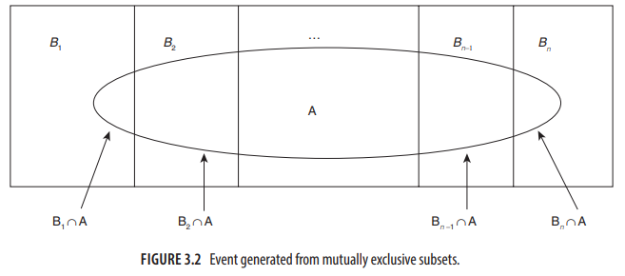
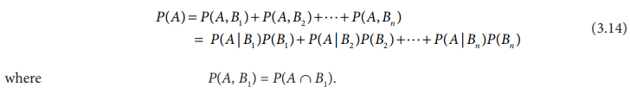
Generalization of Bayes’ Theorem
The probability of evidence P(A) may come from mutually exclusive subsets (events) as described in Figure 3.2.
For better understating, consider a part manufactured by different suppliers B1 , B2 , ..., Bn . Let A denote a defective part. P(A) can be written as:

Slide 38
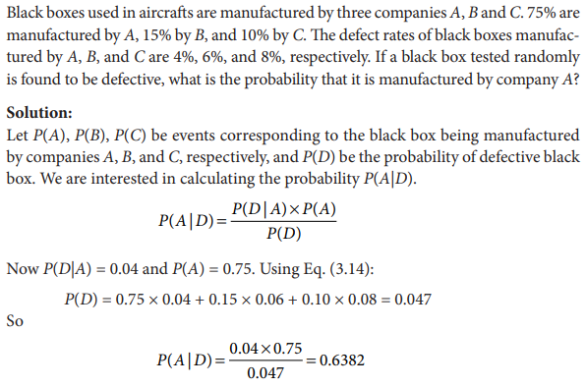
Bayes’ Theorem-example

Slide 39
There are three urns containing 3 white and 2 black balls; 2 white and 3 black balls; 1 black and 4 white balls respectively. There is an equal probability of each urn being chosen. One ball is equal probability chosen at random. what is the probability that a white ball is drawn?
Let E1, E2, and E3 be the events of choosing the first, second, and third urn respectively. Then,
P(E1) = P(E2) = P(E3) =1/3
Let E be the event that a white ball is drawn. Then,
P(E/E1) = 3/5, P(E/E2) = 2/5, P(E/E3) = 4/5
By theorem of total probability, we have
P(E) = P(E/E1) . P(E1) + P(E/E2) . P(E2) + P(E/E3) . P(E3)
= (3/5 * 1/3) + (2/5 * 1/3) + (4/5 * 1/3)
= 9/15 = 3/5

Slide 40
Bayes’ Theorem- example
At an electronics plant, it is known from past experience that the probability is 0.83 that a new worker who has attended the company’s training program will meet the production quota and that the corresponding probability is 0.35 for a new worker who has not attended the company’s training program. If 80 % of all new workers attend the training program, what is the probability that a new worker will meet the production quota? Also, find the probability that a new worker who meets the production quota will have attended the company’s training program.

Slide 41
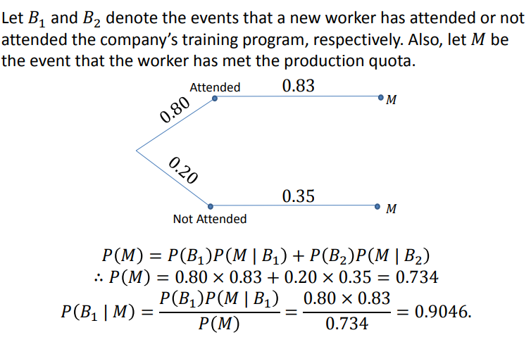

Slide 42
Bayes’ Theorem- example
60% of the companies that increased their share price by more than 5% in the last three years replaced their CEOs during the period.
At the same time, only 35% of the companies that did not increase their share price by more than 5% in the same period replaced their CEOs. Knowing that the probability that the stock prices grow by more than 5% is 4%, find the probability that the shares of a company that fires its CEO will increase by more than 5%.

Slide 43
Bayes’ Theorem- example
Before finding the probabilities, you must first define the notation of the probabilities.
P(A) – the probability that the stock price increases by 5%
P(B) – the probability that the CEO is replaced
P(A|B) – the probability of the stock price increases by 5% given that the CEO has been replaced
P(B|A) – the probability of the CEO replacement given the stock price has increased by 5%.

Slide 44

Using the Bayes’ theorem, we can find the required probability:
Thus, the probability that the shares of a company that replaces its CEO will grow by more than 5% is 6.67%.

Slide 45
Random Variable
A variable is defined as any symbol that can take any particular set of values.
If the value of a variable depends upon the outcome of a random experiment, it is a random variable and can take up any real value.
Such an experiment, where we know the set of all possible results but find its impossible to predict one at any particular execution, is a random experiment.
Mathematically, a random variable is a real-valued function whose domain is a sample space S of a random experiment.
Random variable is always denoted by capital letter like X,Y,M.
Lowercase letters like x, y, z, m etc. represent its value.

Slide 46
Random Variable
X denotes the Probability Distribution of random variable X.
P(X) denotes the Probability of X.
p(X=x) denotes the Probability that random variable X is equivalent to any particular value, represented by x.
Experiment is tossing a coin 2 times.
Sample space(S) is {HH, TH, HT, TT}.
X(Random Variable) is the number of both heads when we toss a coin 2 times.
P(X=HT)=0.25, P(X=TT)=0.25, P(X=HH)=0.25, P(X=HT)=0.25
For outcome {HT},
Then, X(HH) = 0, X(TH) = 0, X(HT) = 1, X(TT) = 0.

Slide 47
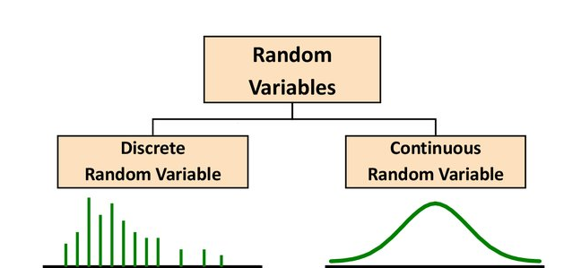
Random Variable
Since there are two forms of data, discrete and continuous, there are two types of random variables.
It can be categorized into two types:
  Discrete Random Variable
  Continuous Random variable

Slide 48
Discrete random variable
If the random variable X can assume only a finite or countably infinite set of values, then it is called a discrete random variable. There are very many situations where the random variable X can assume only finite or countably infinite set of values.
Examples of discrete random variables are:
Credit rating (usually classified into different categories such as low, medium and high or using labels such as AAA, AA, A, BBB, etc.).
Number of orders received at an e-commerce retailer which can be countably infinite.
Customer churn [the random variables take binary values: (a) Churn and (b) Do not churn].
Fraud [the random variables take binary values: (a) Fraudulent transaction and (b) Genuine transaction].
Any experiment that involves counting (for example, number of returns in a day from customers of e-commerce portals such as Amazon, Flipkart; number of customers not accepting job offers from an organization).

Slide 49
Continuous random variable
A random variable X which can take a value from an infinite set of values is called a continuous random variable.
Examples of continuous random variables are listed below:
Market share of a company (which take any value from an infinite set of values between 0 and 100%).
Percentage of attrition among employees of an organization.
Time to failure of engineering systems.
Time taken to complete an order placed at an e-commerce portal.
Time taken to resolve a customer complaint at call and service centers.
Height, Weight, Amount of rainfall, etc.
In many situations, a continuous variable may be converted to a discrete random variable for modelling purpose.

Slide 50
Probability Distributions
A probability distribution is a function that calculates the likelihood of all possible values for a random variable.
For any event of a random experiment, we can find its corresponding probability.
For different values of the random variable, we can find its respective probability.
The values of random variables along with the corresponding probabilities are the probability distribution of the random variable.
A probability distribution and probability mass functions can both be used to define a discrete probability distribution.
A continuous probability distribution is described using a probability distribution function and a probability density function.

Slide 51
Discrete Random Variables
The probability distribution of a discrete random variable is a list of probabilities associated with each of its possible values.
It is also sometimes called the probability function or the probability mass function.
More formally, the probability distribution of a discrete random variable X is a function which gives the probability p(xi) that the random variable equals xi, for each value xi:
p(xi) = P(X=xi)
It satisfies the following conditions:
0 <= p(xi) <= 1
sum of all p(xi) is 1

Slide 52
Discrete Random Variables
Consider a random variable X= number of heads after tossing a coin thrice.
x ∈ {0,1,2,3}.
All the possible outcomes after a coin is flipped thrice are, {HHH,HHT,HTT,TTT,TTH,THH,THT,HTH}.
What will be the probability that 0 heads occur?
We denote it as P(X=0)=1/8=0.125
probability of getting exactly 1 head=P(X=1)=3/8=0.375
P(X=2)=3/8=0.375
P(x=3)=1/8=0.125
If we sum up the probabilities of all outcomes, it will be equal to one. This gives us the Probability Distribution of that random variable.

Slide 53
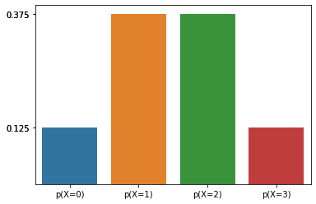
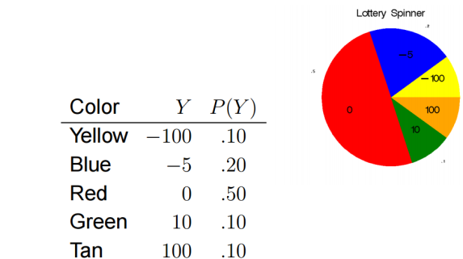
Probability Mass Function(PMF) of Discrete Random Variable
In the case of Discrete Random Variables, the function that denotes the probability of the random variable for each x in the range of X is known as the Probability Mass Function(PMF).
It can be shown using tables or graph or mathematical equation.

Slide 54

Probability Distribution Function(PDF) of Discrete Random Variable
Note that the values of x take on all possible cases. and the sum of the probabilities add to 1. mathematically, this can be written as f(x) = p(x = x). the set of ordered pairs (x, f(x)) is called the probability function, probability mass function or probability distribution function of the discrete random variable x. f(x) is considered a probability mass function if it satisfies the following conditions:
In case of rolling of a die, the probability of each value X can take is the same. So the probability distribution in this case will be:
P(X=1) = 1/6, P(X=2) = 1/6 and so on.
Note that the values of x take on all possible cases. And the sum of the probabilities add to 1.

Slide 55
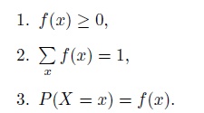
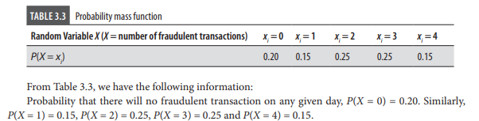
Probability Distribution Function(PDF) of Discrete Random Variable
Mathematically, this can be written as f(x) = P(X = x).
The set of ordered pairs (x, f(x)) is called the probability function, probability mass function or probability distribution function of the discrete random variable X.
f(x) is considered a probability mass function if it satisfies the following conditions:
Example

Slide 56

Cumulative distribution Function(CDF) of Discrete Random Variable
However, many times we may wish to compute the probability that the random variable X be lesser than or equal to some real number x.
Writing F(x) = P(X ≤ x) for every real number x, we define F(x) to be the cumulative distribution function of the random variable X.
Example 1
Cumulative distribution function, F(xi ), is the probability that the random variable X takes values less than or equal xi . That is, F(xi ) = P(X ≤ xi ).
F(2) = P(X ≤ 2) = P(X = 0) + P(X = 1) + P(X = 2) = 0.60

Slide 57
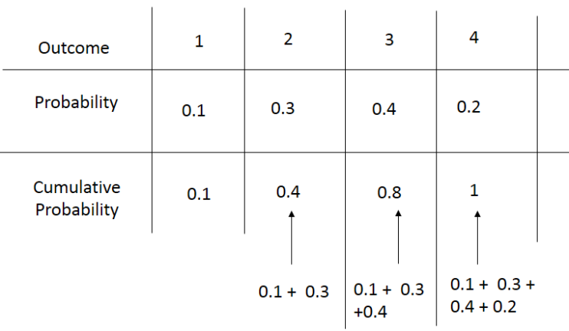
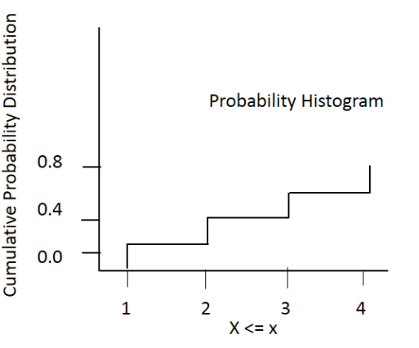
Example 2
The probability of X is less than or 1 is 0.1.
Similarly, probability of X is less than or equal to 2 is (0.1+0.3) =0.4 and so on.

Slide 58

PROBABILITY DENSITY FUNCTION (PDF) AND CUMULATIVE DISTRIBUTION FUNCTION (CDF) OF A CONTINUOUS RANDOM VARIABLE
The probability of a continuous random variable assuming exactly any of its values is 0.
Hence, the probability distribution for a continuous random variable cannot be given in tabular form.
The probability density function of a continuous random variable is a function which can be integrated to obtain the probability that the random variable takes a value in a given interval.
The probability for a continuous random variable is always computed at intervals : P(a≤X≤b).
The probability distribution of a continuous random variable can be stated as a formula; and f(x) is called the probability density function, or simply a density function, of X.

Slide 59
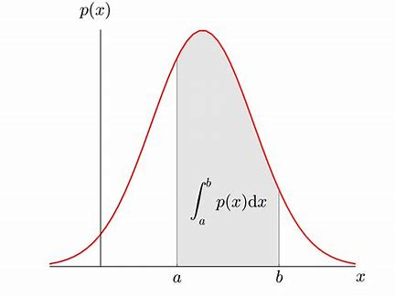
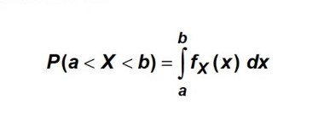
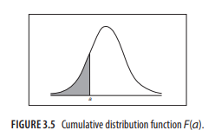

PROBABILITY DENSITY FUNCTION (PDF) AND CUMULATIVE DISTRIBUTION FUNCTION (CDF) OF A CONTINUOUS RANDOM VARIABLE
Here probability is given by the surface area under the curve with a interval. To find the probability of a certain interval, say a to b, we find the area under that curve by integrating the PDF in that interval.
fₓ(x) is the Probability Density Function
And the cumulative distribution function F(x) of a continuous random variable is given by:

Slide 60
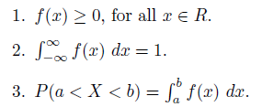


PROBABILITY DENSITY FUNCTION (PDF) AND CUMULATIVE DISTRIBUTION FUNCTION (CDF) OF A CONTINUOUS RANDOM VARIABLE
Probability density function and cumulative distribution function of a continuous random variable satisfy the following properties:
The expected value of a continuous random variable, E(X), is given by
The variance of a continuous random variable, Var(X), is given by

Slide 61
Probability Distribution
Summary
Depending on type of random variables, its probability distribution can be categorized into :
Discrete probability distributions
Continuous probability distributions

Slide 62
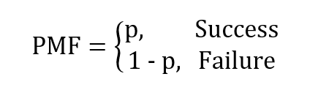
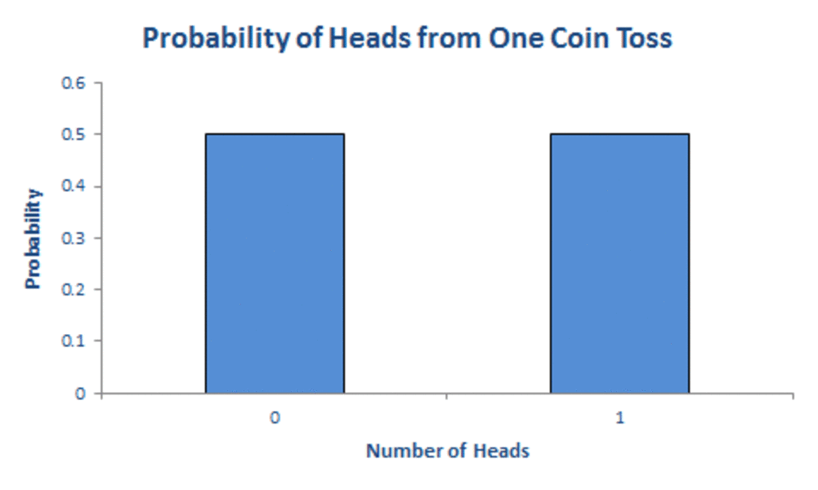
Bernoulli Distribution
This distribution is generated when we perform an experiment once and it has only two possible outcomes – success and failure.
The trials of this type are called Bernoulli trials, which form the basis for many distributions
Let p be the probability of success and 1 – p is the probability of failure.
The PMF is given as
Examples:
flipping a coin once. p is the probability of getting a head and 1 – p is the probability of getting a tail.
Will you pass or fail a test?
Will your favourite sports team win or lose their next match?
Will you be accepted or rejected for that job you applied for?

Slide 63
Binomial Distribution
Binomial distribution is one of the most important discrete probability distribution due to its applications in several contexts. A random variable X is said to follow a Binomial distribution when
1. The random variable can have only two outcomes success and failure (also known as Bernoulli trials).
2. The objective is to find the probability of getting k successes out of n trials.
3. The probability of success is p and thus the probability of failure is (1 − p).
4. The probability p is constant and does not change between trials.
Success and failure are generic terminologies used in binomial distribution; based on the context, the interpretation will change (winning a lottery can be considered as success and not winning as failure).

Slide 64
Binomial Distribution
In analytics, the following are few example problems that can be associated with Binomial distribution:
Customer churn where the outcomes are: (a) Customer churn and (b) No customer churn.
Fraudulent insurance claims where the outcomes are: (a) Fraudulent claim and (b) Genuine claim.
Loan repayment default by a customer where the outcomes are: (a) Default and (b) No default.
Cart abandonment in e-commerce (a situation where the customer adds items to his/her cart but does not make the purchase), where the outcomes are: (a) Cart abandonment and (b) No cart abandonment.
Employee attrition at a company where the outcomes are: (a) The employee leaves (exits) the company and (b) The employee does not leave the company.
Any business context in which there are only two outcomes can be analysed using Binomial distribution

Slide 65
Binomial Distribution
Example:
Flipping a coin n number of times and calculating the probabilities of getting a particular number of heads.
More real-world examples include the number of successful sales calls for a company or whether a drug works for a disease or not.
Number of winning lottery tickets when you buy 10 tickets of the same kind
Number of left-handers in a randomly selected sample of 100 unrelated people

Slide 66
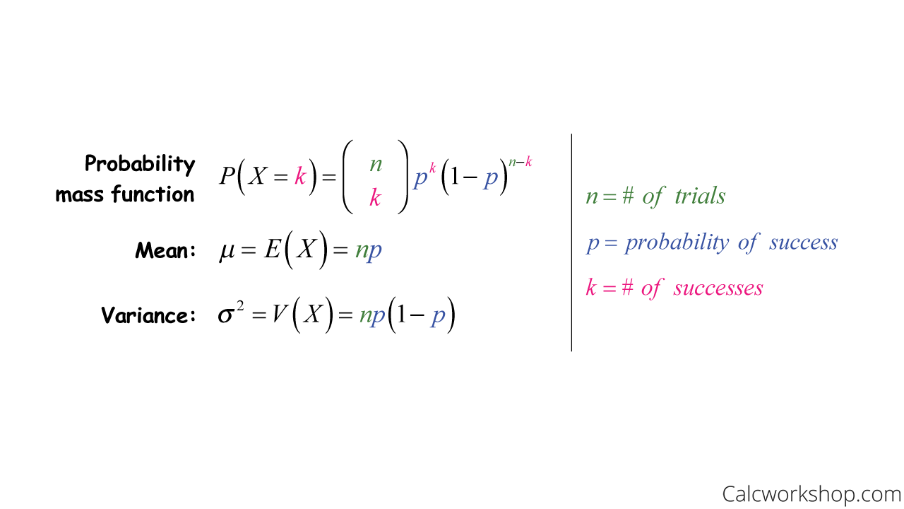
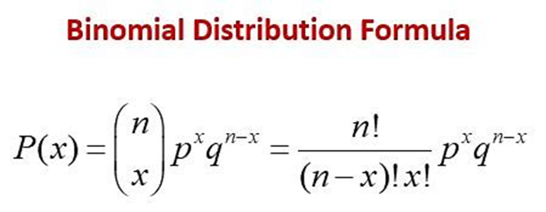
Binomial Distribution

Slide 67
Binomial Distribution
For example, suppose we shuffle a standard deck of cards, and we turn over the top card. We put the card back in the deck and reshuffle. We repeat this process five times. Let X equal the number of Jacks we observe. Is this a binomial distribution?
B – binary – yes, either it’s a Jack or it isn’t
I – independent – yes, because we replace the card each time, the trials are independent.
N – number of trials fixed in advance – yes, we are told to repeat the process five times.
S – successes (probability of success) are the same – yes, the likelihood of getting a Jack is 4 out of 52 each time you turn over a card.
Therefore, this is an example of a binomial distribution.

Slide 68
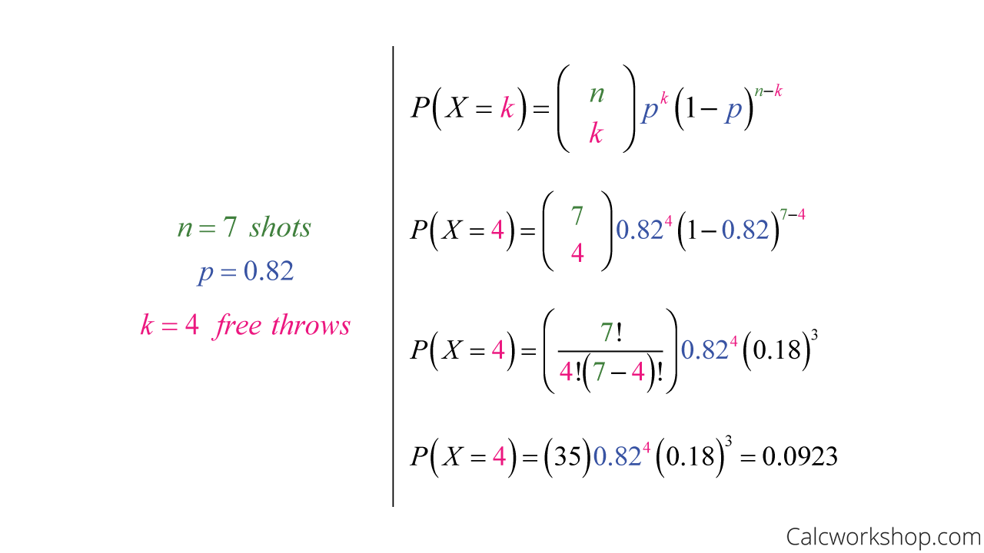
Suppose that Charlie makes a free throw has probability of 0.82 on any one try. Assuming that this probability doesn’t change, find the chance that Charlie makes 4 out of the next seven free throws.

Slide 69
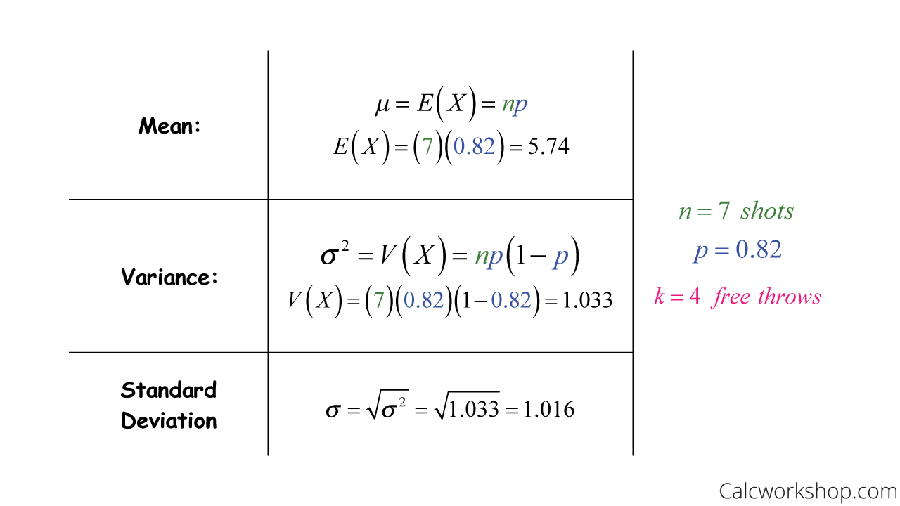
let’s determine the number of free throws Charlie should expect to make and the standard deviation.

Slide 70
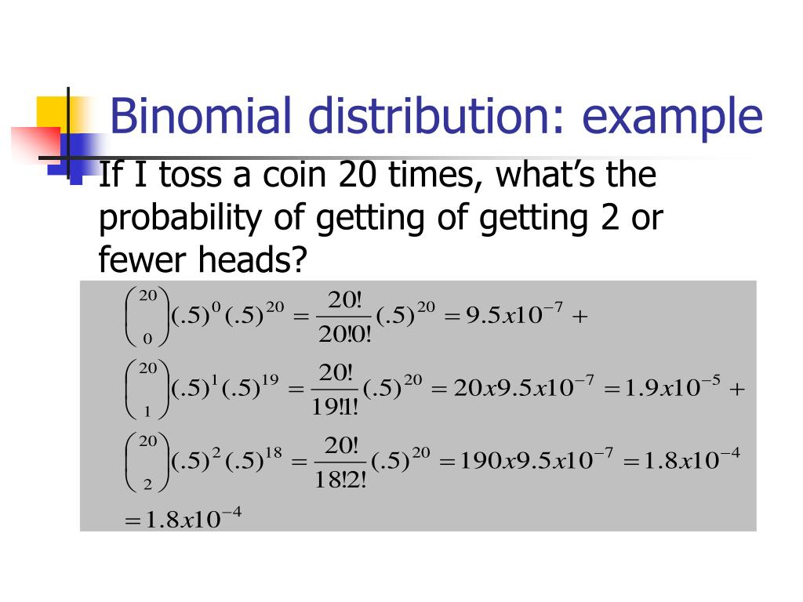
Example

Slide 71
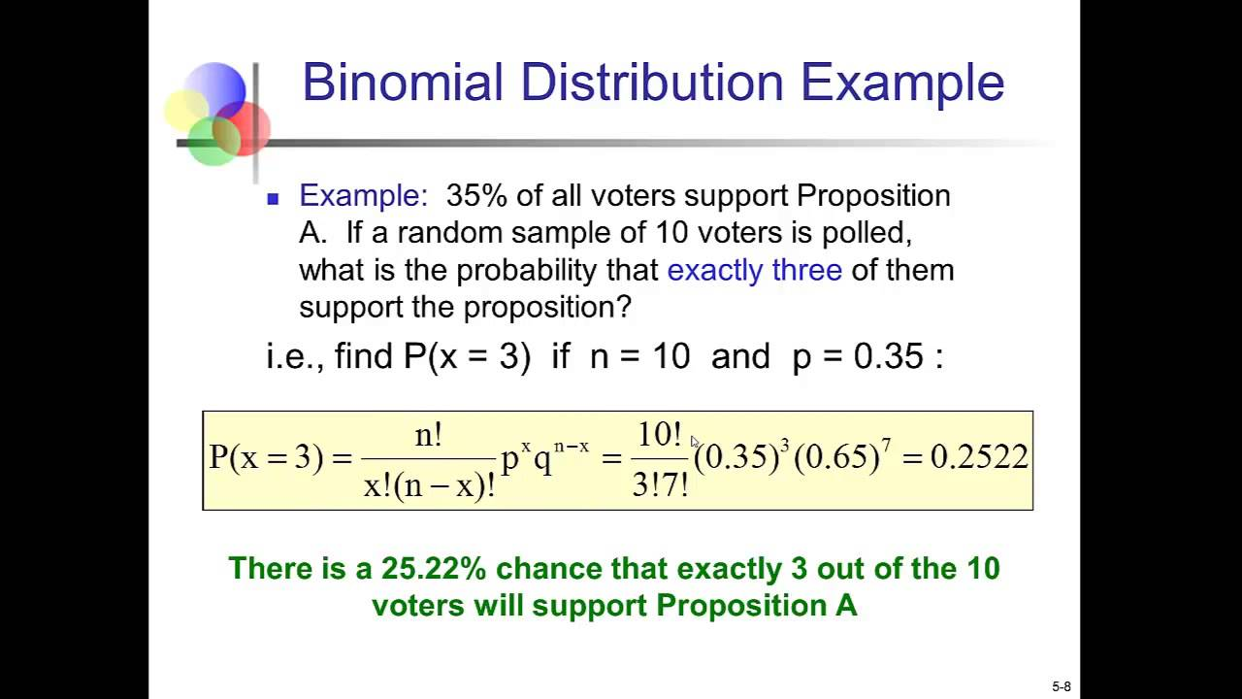
Example

Slide 72
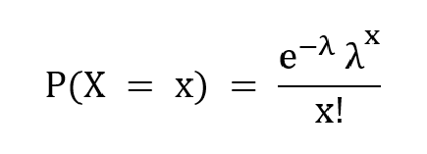
Poisson Distribution
It describes the events that occur in a fixed interval of time or space.
Examples:
Consider the case of the number of calls received by a customer care center per hour. We can estimate the average number of calls per hour but we cannot determine the exact number and the exact time at which there is a call. Each occurrence of an event is independent of the other occurrences.
The PMF is given as,

Slide 73
Poisson Distribution
where λ is the average number of times the event has occurred in a certain period of time,
x is the poisson random variable (with desired outcome)
and e is the base of logarithm , Euler’s number, and e = 2.71828 (approx).

Slide 74
Properties of Poisson Distribution
The occurrence of the event are independent in an interval.
An infinite number of occurrences of the of the event are possible in the interval.
The probability of a single event in the interval is proportional to the length of the event.
In an infinitely small portion of the interval, the probability of more than one occurrence of the event is negligible.
The Poisson distribution is limited when the number of trials n is indefinitely large.
If the mean is large, then the Poisson distribution is approximately a normal distribution.

Slide 75
Poisson Distribution
In Poisson distribution, the mean is represented as μ = E(X) = λ.
The mean and the variance of Poisson Distribution are equal. It means that E(X) = V(X)
Where,
V(X) is the variance.
The standard deviation is always equal to the square root of the mean μ.

Slide 76
Applications of Poisson Distribution
To count the number of defects of a finished product
To count the number of deaths in a country by any disease or natural calamity
To count the number of infected plants in the field
To count the number of bacteria in the organisms or the radioactive decay in atoms
To calculate the waiting time between the events.

Slide 77
Poisson Distribution-Example
In a cafe, the customer arrives at a mean rate of 2 per min. Find the probability of arrival of 5 customers in 1 minute using the Poisson distribution formula.
Solution:
Given: λ = 2, and x = 5.
Using the Poisson distribution formula:
P(X = x) = (e^{-λ} λ^{x} )/x!
P(X = 5) = (e⁻² 2⁵ )/5!
P(X = 5) = 0.036
Answer: The probability of arrival of 5 customers per minute is 3.6%.

Slide 78
Poisson Distribution-Example
Find the mass probability of function at x = 6, if the value of the mean is 3.4.
Solution:
Given: λ = 3.4, and x = 6.
Using the Poisson distribution formula:
P(X = x) = (e^{-λ} λ^{x} )/x!
P(X = 6) = (e^{-3.4} 3.4⁶ )/6!
P(X = 6) = 0.072
Answer: The probability of function is 7.2%.

Slide 79
Poisson Distribution-Example
If 3% of electronic units manufactured by a company are defective. Find the probability that in a sample of 200 units, less than 2 bulbs are defective.
Solution:
The probability of defective units p = 3/100 = 0.03
Give n = 200.
We observe that p is small and n is large here. Thus it is a Poisson distribution.
Mean λ= np = 200 × 0.03 = 6
P(X= x) is given by the Poisson Distribution Formula as (e^{-λ} λ^{x} )/x!
P(X < 2) = P(X = 0) + P(X= 1)
=(e⁻⁶ 6⁰ )/0! + (e⁻⁶6¹ )/1!
= e⁻⁶ + e⁻⁶ × 6
= 0.00247 + 0.0148
P(X < 2) = 0.01727
Answer: The probability that less than 2 bulbs are defective is 0.01727

Slide 80
Continuous probability distributions
These distributions model the probabilities of random variables that can have any possible outcome, also real.
Two continuous probability distribution function are associated with such continuous random variables:
Probability Density Function (PDF)
Cumulative Density/Distribution Function(CDF)
For example, the possible values for the random variable X that represents weights of citizens in a town which can have any value like 34.5, 47.7, etc.,
Examples: Normal, Student’s T, Chi-square, Exponential, etc.,

Slide 81
Probability Density function
Probability Density function (PDF) estimate the probability that it lies within a particular range of values for any given outcome(continuous) for continuous distributions.

Slide 82
Cumulative Distribution Function
The Cumulative Distribution Function of X, evaluated at x is the probability that X will take a value less than or equal to x.

Slide 83
Continuous probability distributions
When working with continuous random variables, such as X, we only calculate the probability that X lie within a certain interval;
like P(X≤k) or P(a≤X≤b).
We don't calculate the probability of X being equal to a specific value k.
In fact the result, P(X=k)=0 , will always be true:
This can be explained by the fact that the total number of possible values of a continuous random variable X is infinite, so the likelihood of any one single outcome tends towards 0.

Slide 84
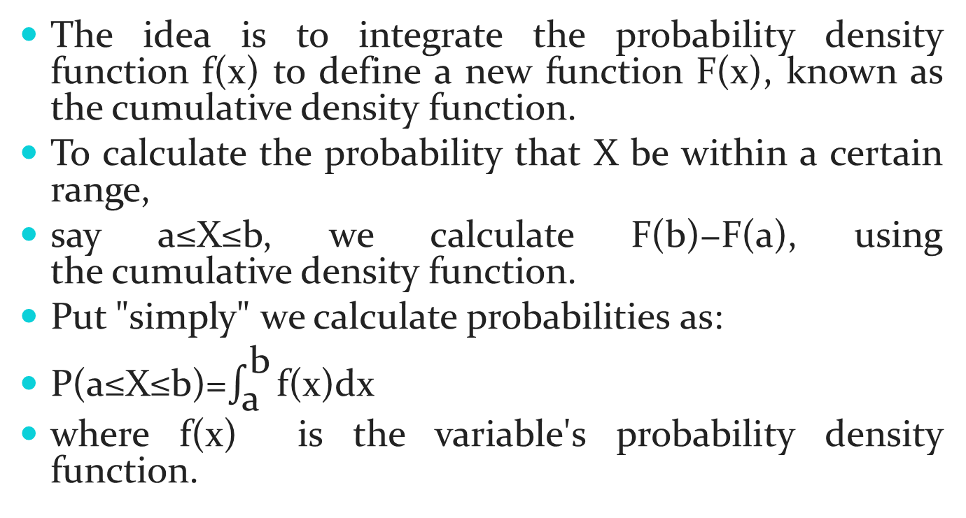
Continuous probability distributions

Slide 85
Normal Distribution
It has two parameters namely mean and standard deviation.
The mean has the highest probability and all other values are distributed equally on either side of the mean in a symmetric fashion.
The standard normal distribution is a special case where the mean is 0 and the standard deviation of 1.
68% of the values are 1 standard deviation away, 95% percent of them are 2 standard deviations away, 99.7% are 3 standard deviations away from mean.

Slide 86
Normal Distribution
The standard normal distribution is one of the forms of the normal distribution. It occurs when a normal random variable has a mean equal to zero and a standard deviation equal to one. In other words, a normal distribution with a mean 0 and standard deviation of 1 is called the standard normal distribution. Also, the standard normal distribution is centred at zero, and the standard deviation gives the degree to which a given measurement deviates from the mean.
A Z score represents how many standard deviations an observation is away from the mean. The mean of the standard normal distribution is 0. Z scores above the mean are positive and Z scores below the mean are negative.
Once you have computed a Z-score, you can look up the probability in a table for the standard normal distribution

Slide 87
Standard Normal Distribution
The random variable of a standard normal distribution is known as the standard score or a z-score. It is possible to transform every normal random variable X into a z score using the following formula:
z = (X – μ) / σ
where X is a normal random variable, μ is the mean of X, and σ is the standard deviation of X. You can also find the normal distribution formula here. In probability theory, the normal or Gaussian distribution is a very common continuous probability distribution.
Standardizing a normal distribution When you standardize a normal distribution, the mean becomes 0 and the standard deviation becomes
This allows you to easily calculate the probability of certain values occurring in your distribution, or to compare data sets with different means and standard deviations.

Slide 88
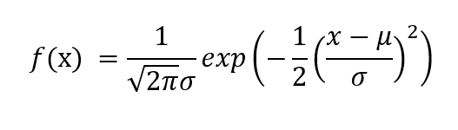
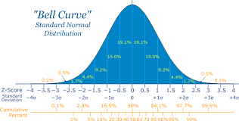
Normal Distribution
The PDF is given by,
where μ is the mean of the random variable X and σ is the standard deviation.

Slide 89
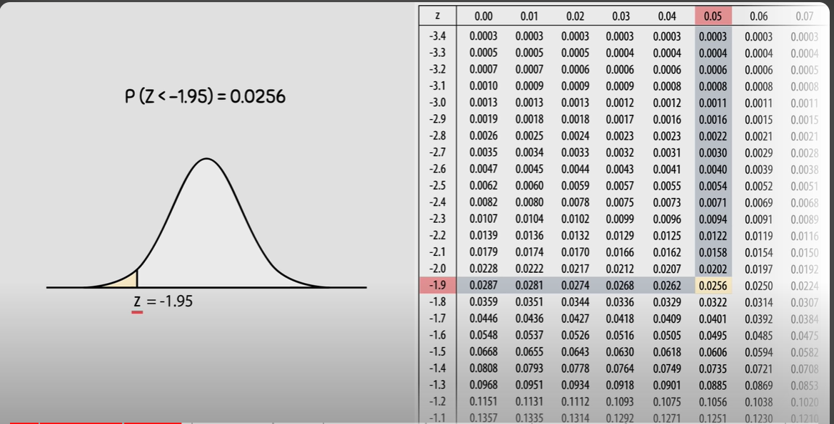
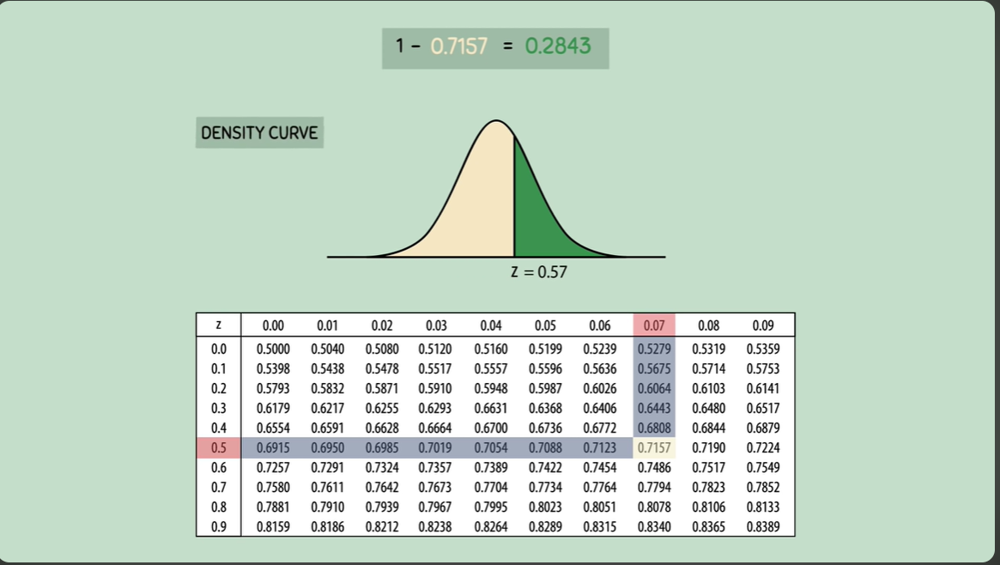

Slide 90
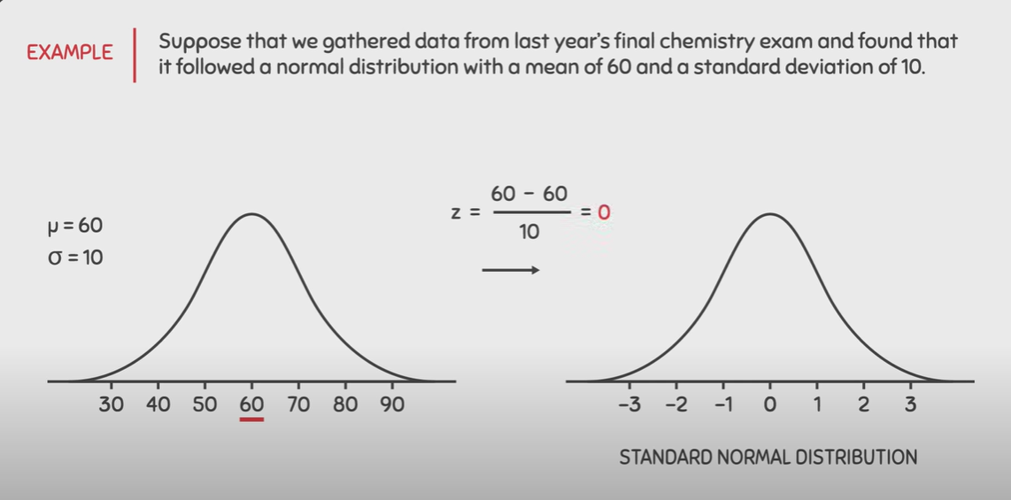
Example

Slide 91
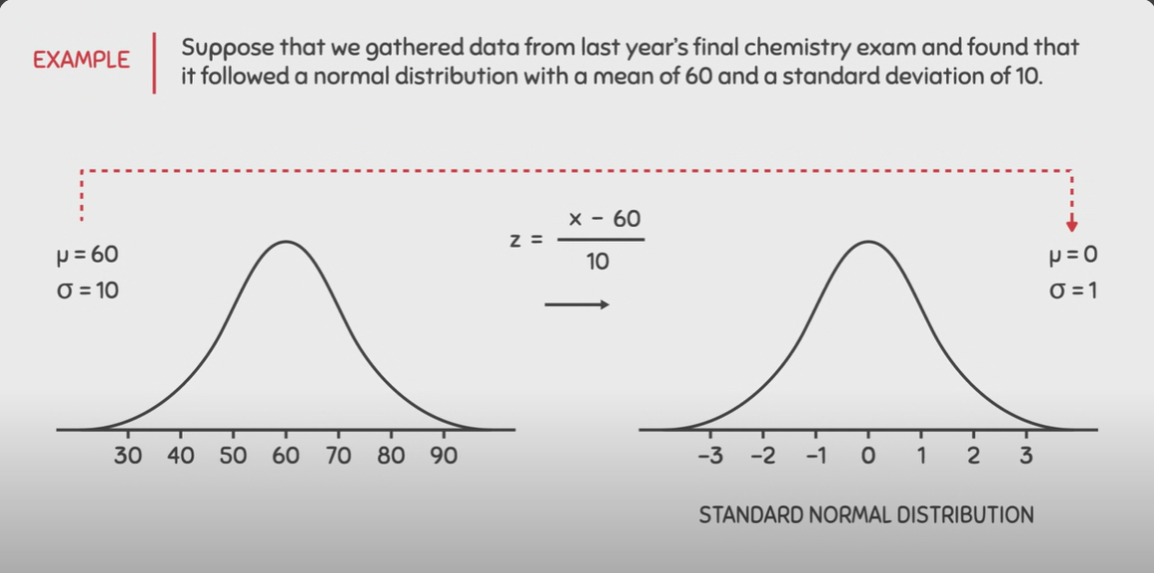
Example

Slide 92
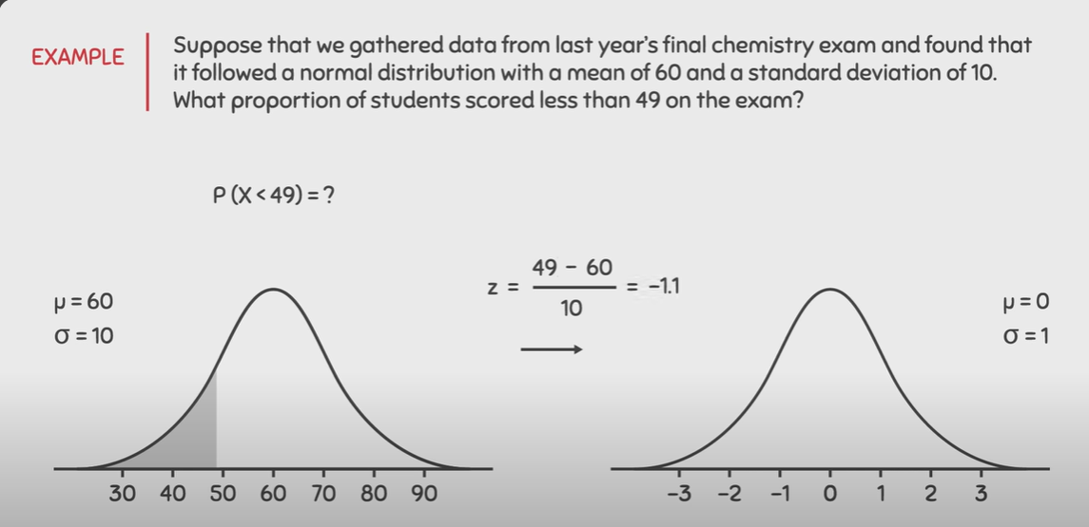
Example

Slide 93
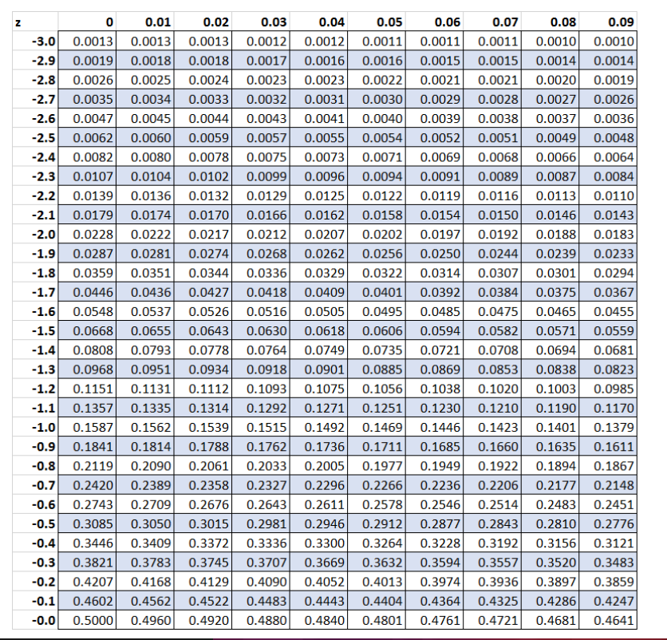
Z table

Slide 94
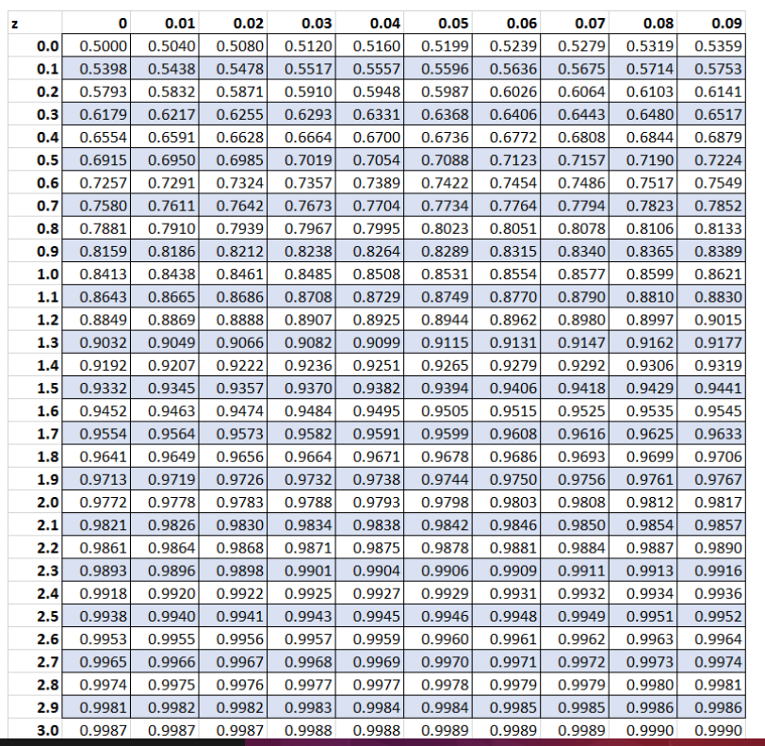
Z table

Slide 95
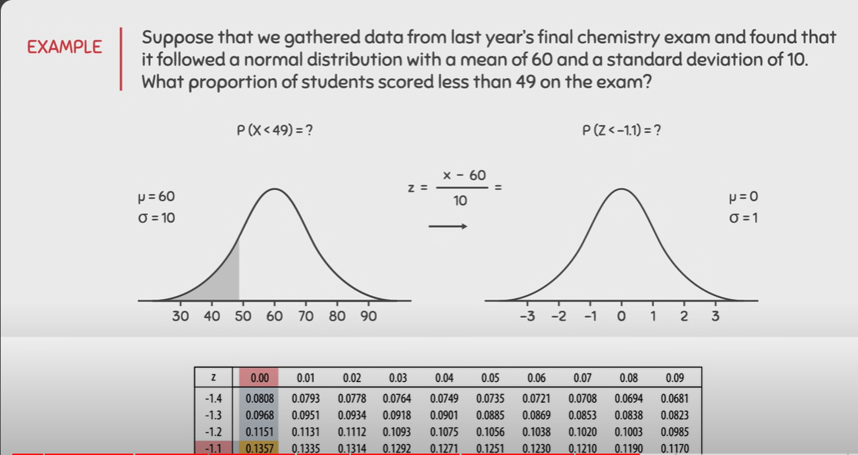
Example

Slide 96
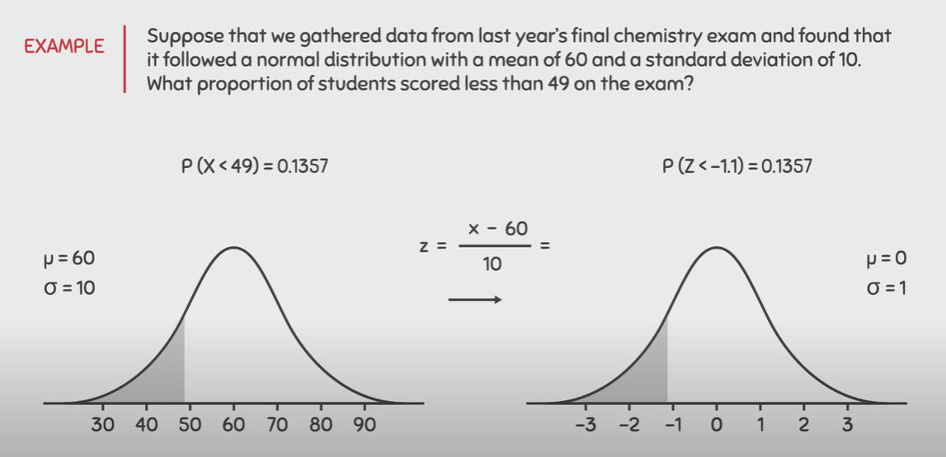
Example

Slide 97
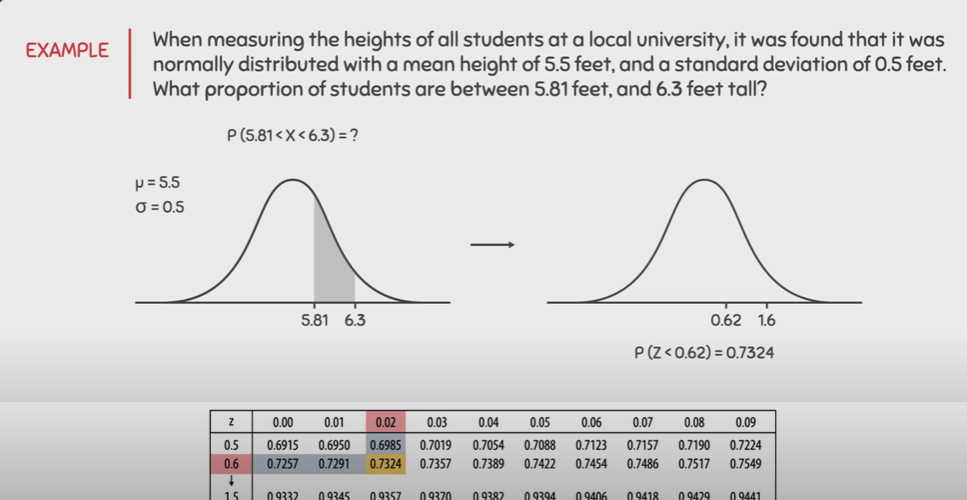
Example2

Slide 98
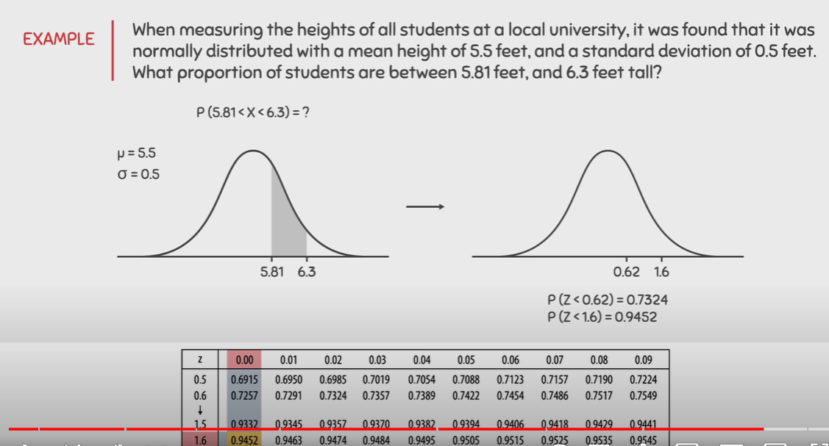
Example2

Slide 99
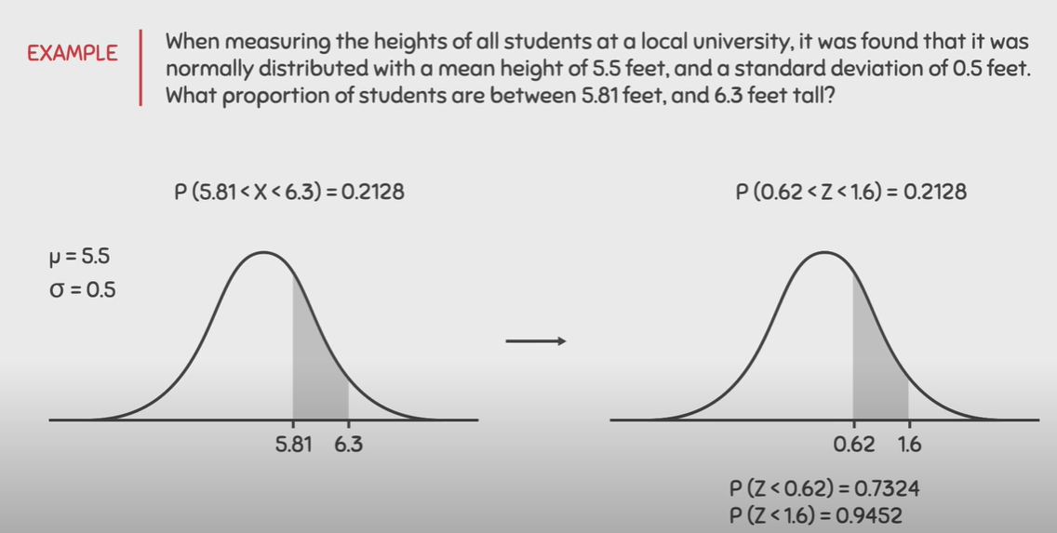
Example2

Slide 100
Exponential Distribution
To predict the amount of waiting time until the next event in a Poisson process (i.e., success, failure, arrival, etc.).
For example, we want to predict the following:
The amount of time until the customer finishes browsing and actually purchases something in your store (success).
The amount of time until the hardware on AWS EC2 fails (failure).
The amount of time you need to wait until the bus arrives (arrival).

Slide 101

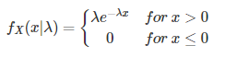
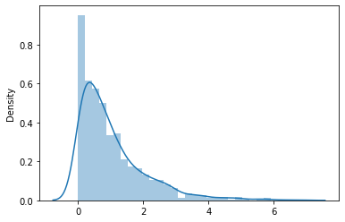
Exponential Distribution
where λ is the rate parameter. λ = 1/(average time between events) = 1/μ
and e=2.71828
The mean of the exponential distribution is 1/λ.
And the variance of the exponential distribution is 1/λ².

Slide 102
Exponential Distribution
For example, suppose the mean number of minutes between eruptions for a certain geyser is 40 minutes. If a geyser just erupts, what is the probability that we’ll have to wait less than 50 minutes for the next eruption?
To solve this, we need to calculate rate parameter:
λ = 1/μ => λ = 1/40 => λ = .025
plug in λ = .025 and x = 50 to the formula for the CDF:
P(X ≤ x) = 1 – e^{-λx =>} P(X ≤ 50) = 1 – e^{-.025(50)}
P(X ≤ 50) = 0.7135

Slide 103

Exponential Distribution
Assume that you usually get 2 phone calls per hour. calculate the probability, that a phone call will come within the next hour.
Solution:
It is given that, 2 phone calls per hour.
So, it would expect that one phone call at every half-an-hour.
So, we can take λ = 0.5
So, the computation is as follows:
= 0.393469
Therefore, the probability of arriving the phone calls within the next hour is 0.393469

